Slide 1

SHYAM TATA COMMERCIAL
, DEPARTMENT WISE PRESENTATION,

Slide 2
FY-21-22 FY-22-23.
YOY TREND

Slide 3
Scv Cargo & Pick Up Market share

Slide 4
Block Wise Retail FY 2022-2023 Scv cargo & pickup

Slide 5
Scv Cargo & Pickup Manpower Status

Slide 6
Retail Targets Dec 2022 (scv pickups&Lcv)

Slide 7
DSE PERFORMANCE SHEET

Slide 8
Trinity Demand (Scv cargo , pickups & Lcv)

Slide 9
Performance Fy-2021-22

Slide 10
Performance Fy-2022-23

Slide 11
Action Plan

Slide 12
FleetEdge Dashboard
File created on: 12/9/2022 10:23:11 PM

Slide 13
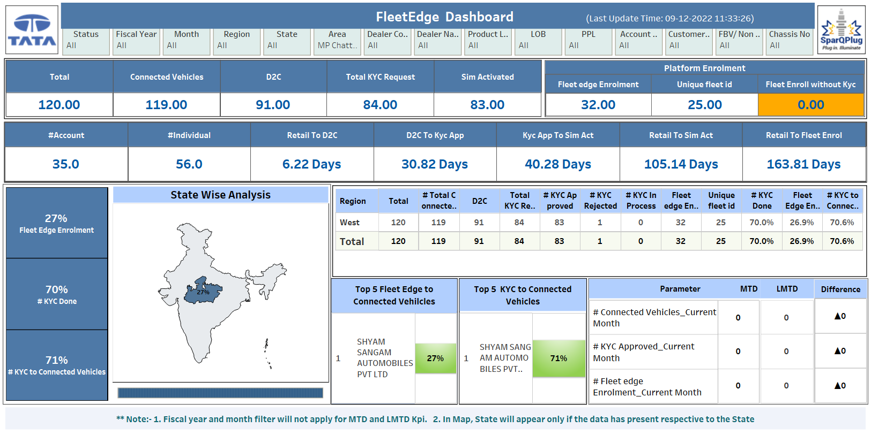

Slide 14
Monthly Job Cards 22-23

Slide 15
Service Revenue 2021-22

Slide 16
Paid Target Vs Revenue

Slide 17
Service Revenue 2022-23

Slide 18
Total Workshop Revenue

Slide 19
Service Psf Trend

Slide 20
Product Issues

Slide 21
Support Required For Service

Slide 22
YEAR WISE RETAIL & OFFTAKE - PASSANGER

Slide 23
COMPARISION WITH LAST YEAR TILL NOV - 2022 (PASSANGER)

Slide 24
DIST. WISE RETAIL TILL NOV - 2022 (PASSANGER)

Slide 25
MONTH WISE PROJECTION RETAIL PLAN - DEC TO MARCH 2023

Slide 26
DIST. WISE RETAIL PLAN - DEC TO MARCH 2023 (PASSANGER)

Slide 27
Current Issues & Support Required

Slide 28
Cpsc Action Plan

